Slide 1
Miami Housing
Carol, Sunayana, Bernard

Slide 2
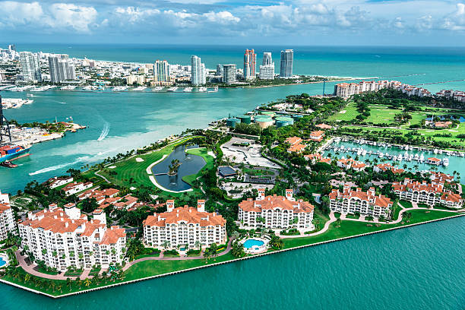
Background-"Exploring Miami's Dynamic Real Estate Scene"
Miami is known for its beautiful beaches, diverse culture, and lively atmosphere. The city's fascinating history, full of vibrant and exotic elements, justifies its well deserved nickname - “the Magic City”.
Our project aims to investigate and understand the key factors influencing housing prices using the Miami Housing Dataset.

Slide 3
Significance and Applications
Investors & Developers:
For those building and investing in real estate projects.
Policymakers:
Influencing regulations and policies for the city's real estate.
Real Estate Agents:
Guiding property transactions and market competitiveness.
Home Seekers and Providers:
Helping buyers and sellers make informed decisions.

Slide 4
Problem Statement:
To identify the variables affecting house prices.The Miami Housing Dataset poses a challenge due to the multifaceted nature of complex variables such as sale price, land area, floor area, amenities proximity, structure characteristics, and geographical coordinates.
Objective:-To create a linear model that quantitatively relates house prices.The main aim is to unravel the relationships and patterns among these variables to achieve a predictive understanding of how they collectively influence and determine housing prices in Miami, employing R programming and statistical analyses.

Slide 5
Dataset
Source and Reliability:
Dataset sourced from Kaggle, a reputable platform known for its diverse datasets, especially in real estate.
Robust dataset with 13,932 rows and 17 columns, free of missing data, ensuring reliability for analysis.
Content Overview:
Covers building-related information (geographical coordinates, age, area, structural quality), location details (proximity to centers, transportation, ocean), and sales information (prices, sale month, special equipment values).

Slide 6
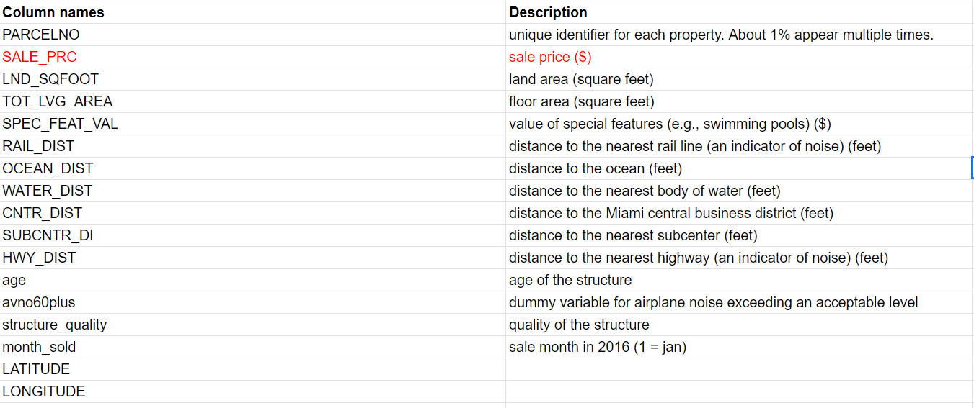
The dataset contains the following 17 columns

Slide 7
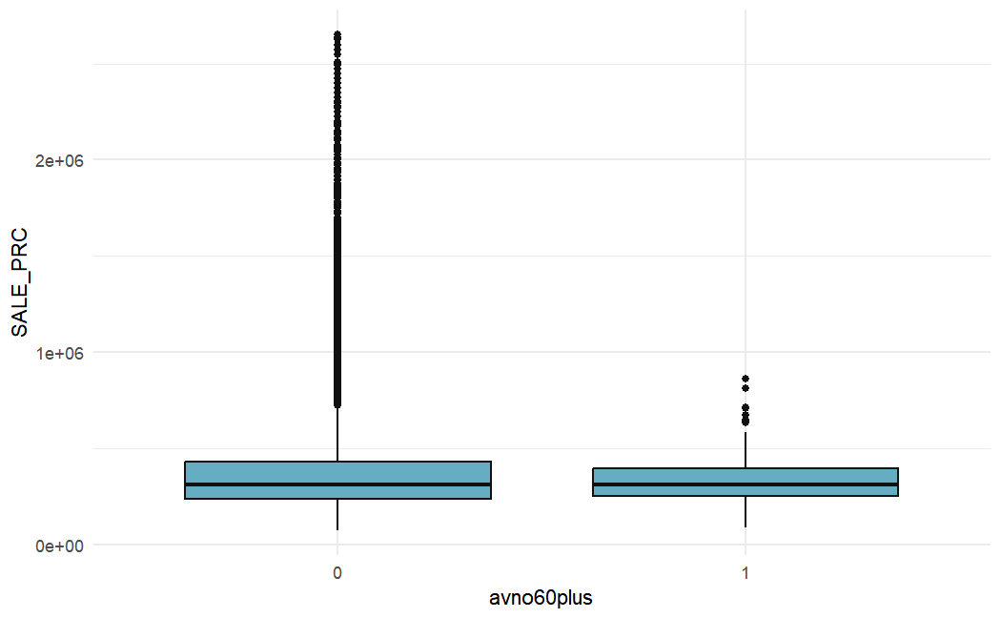
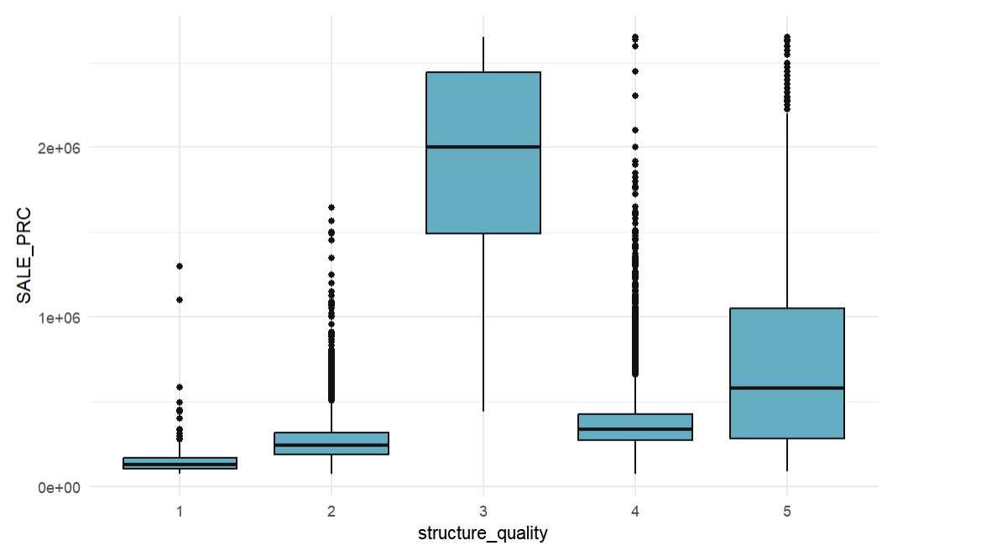
Boxplot (Categorical variables)

Slide 8
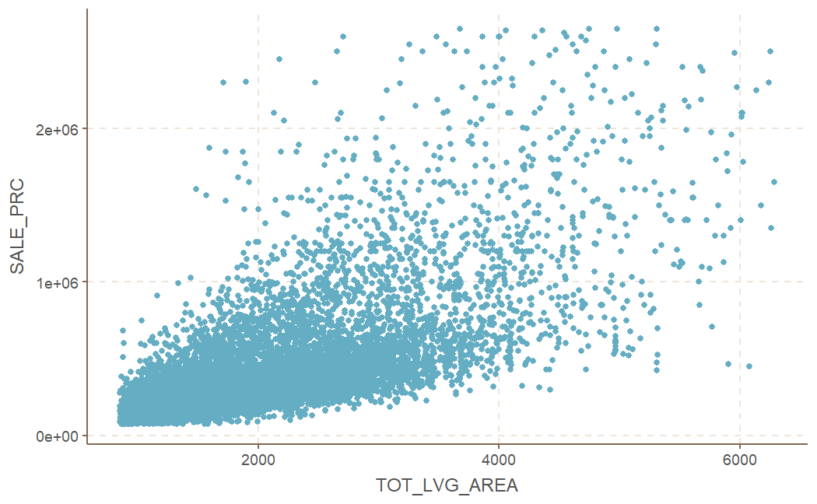
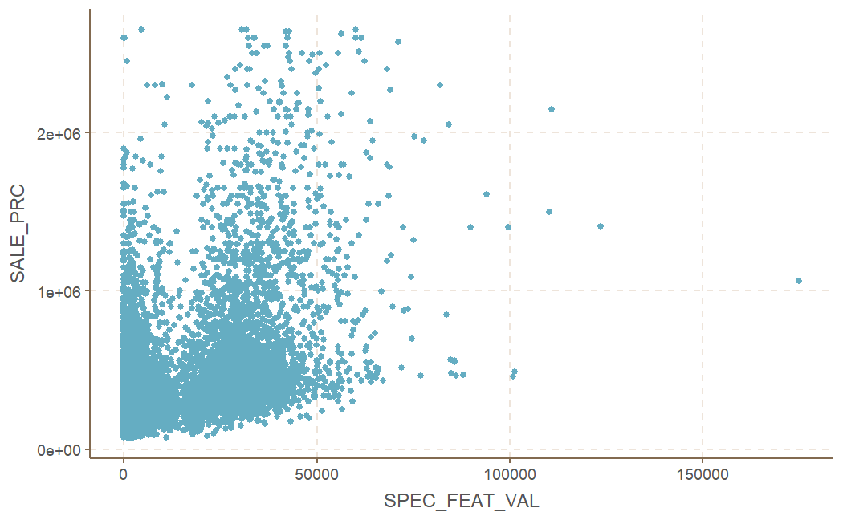
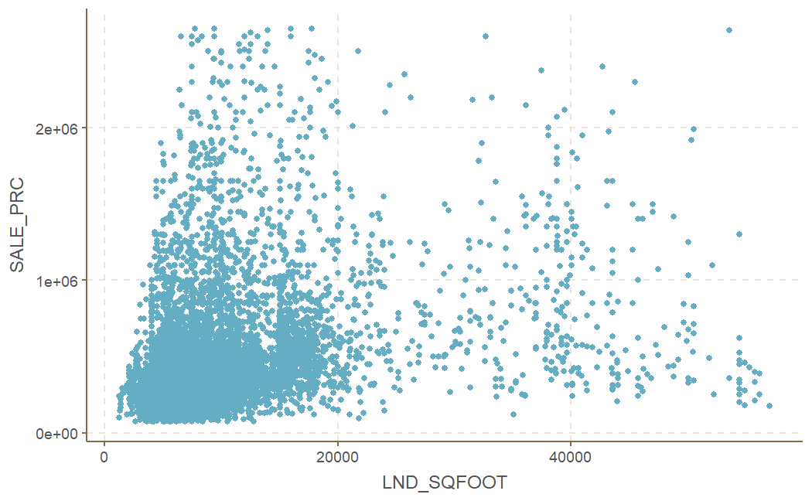
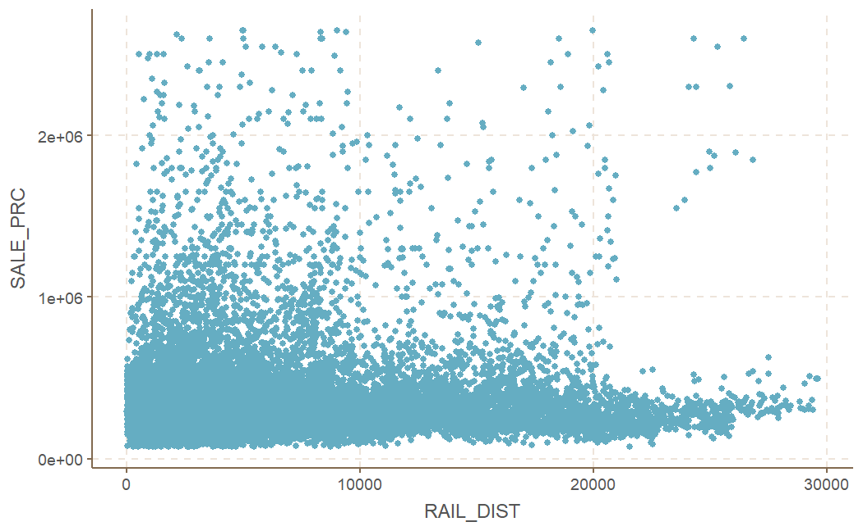
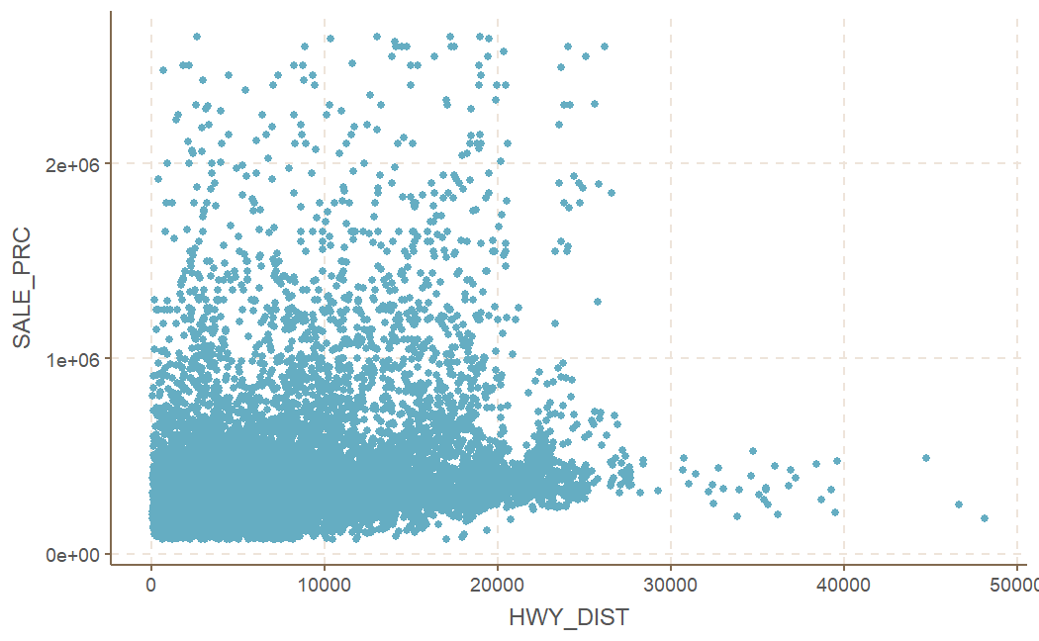
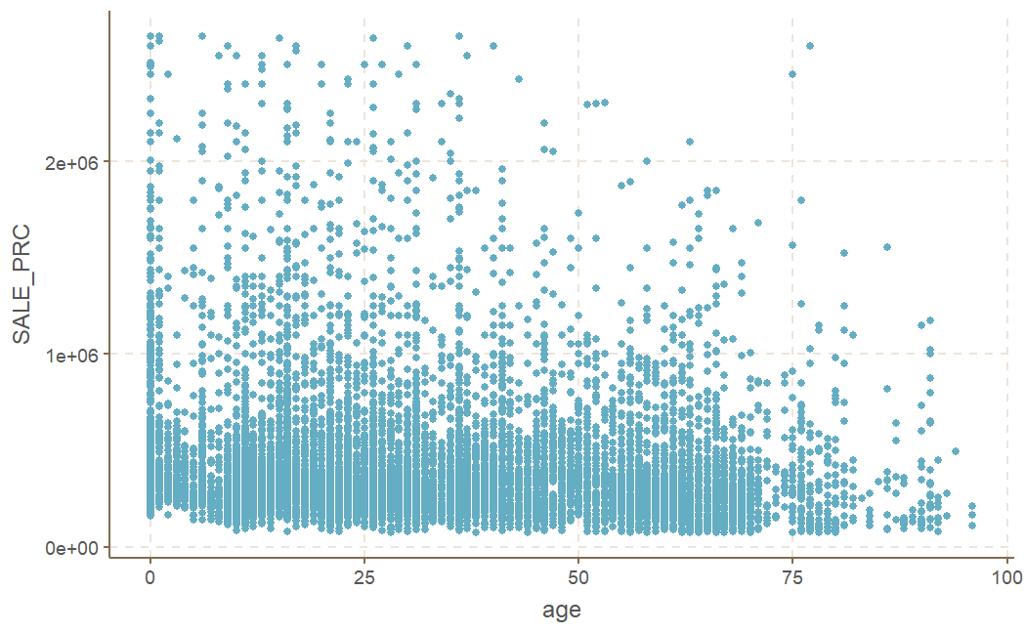
Scatterplot（continuous variables)

Slide 9
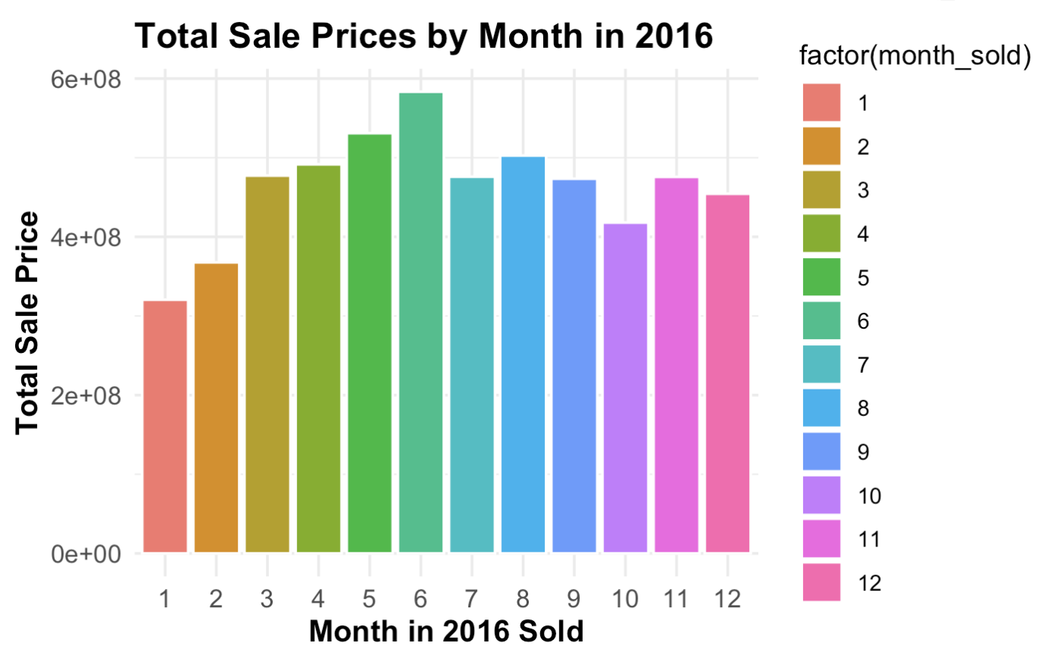

Slide 10
Preparing data
Checking Null values
Data normalization
encoding categorical variables
Method
is.na(miami_housing)
scale(continious predictors）
as.factor(categorical predictors)
to ensure fair and unbiased comparisons preventing larger-scale variables from unduly influencing the results.
to know the different effect of every class in categorical predictors
May lead to inaccurate or biased results if not handled properly.
Reason
transform the data in such a way that it has a mean of 0 and a standard deviation of 1.
avno60plus1
structure_quality2
structure_quality3
structure_quality4
structure_quality5
Result
No missing data in the dataset

Slide 11
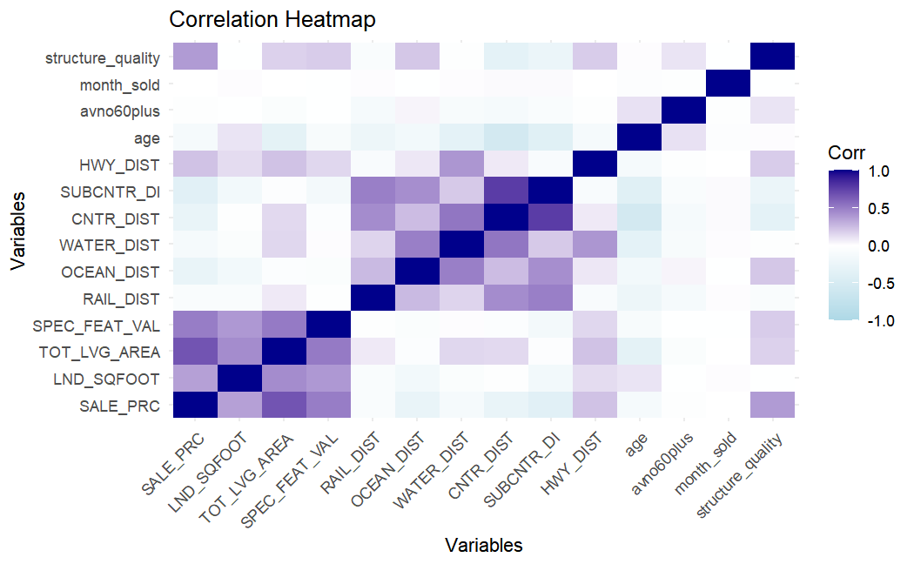
correlation coefficients
0

Slide 12
Initial Model
Call:
lm(formula = log(SALE_PRC) ~ LND_SQFOOT + TOT_LVG_AREA + SPEC_FEAT_VAL +
RAIL_DIST + OCEAN_DIST + WATER_DIST + CNTR_DIST + SUBCNTR_DI +
HWY_DIST + age + avno60plus + structure_quality, data = normal)
Summary(model)
Residual standard error: 0.2675 on 13916 degrees of freedom
Multiple R-squared: 0.7783, Adjusted R-squared: 0.7781
F-statistic: 3257 on 15 and 13916 DF, p-value: < 2.2e-16

Slide 13
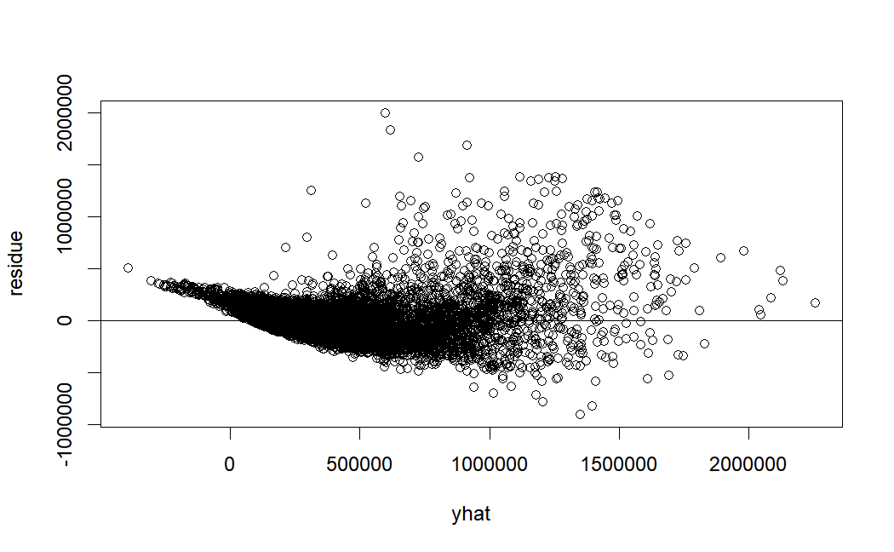
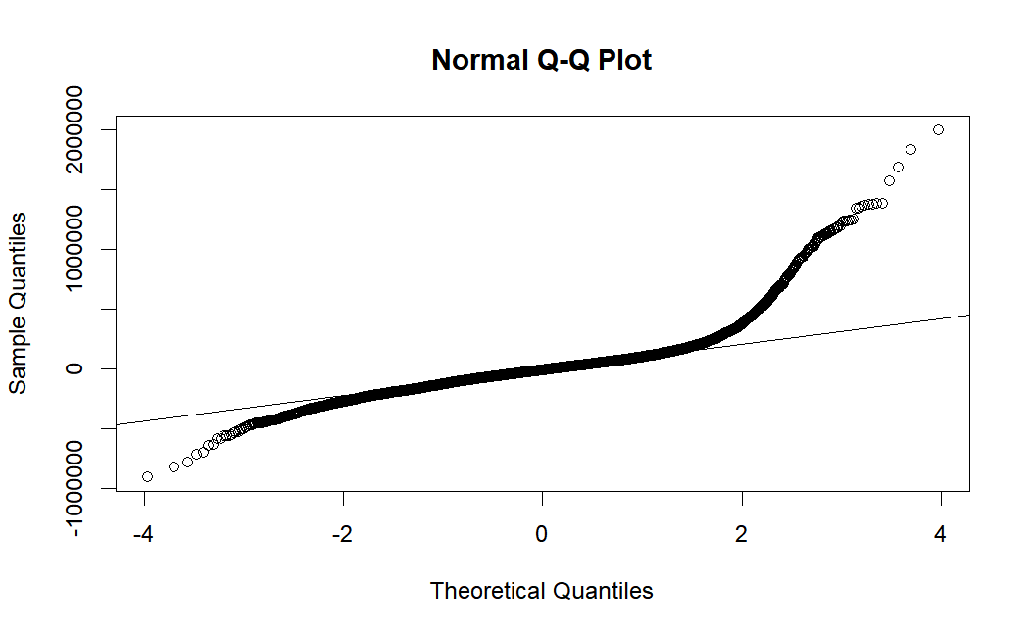
Residuals Check
Long right upper tail suggesting presence of outliers or skweness toward higher values

Slide 14
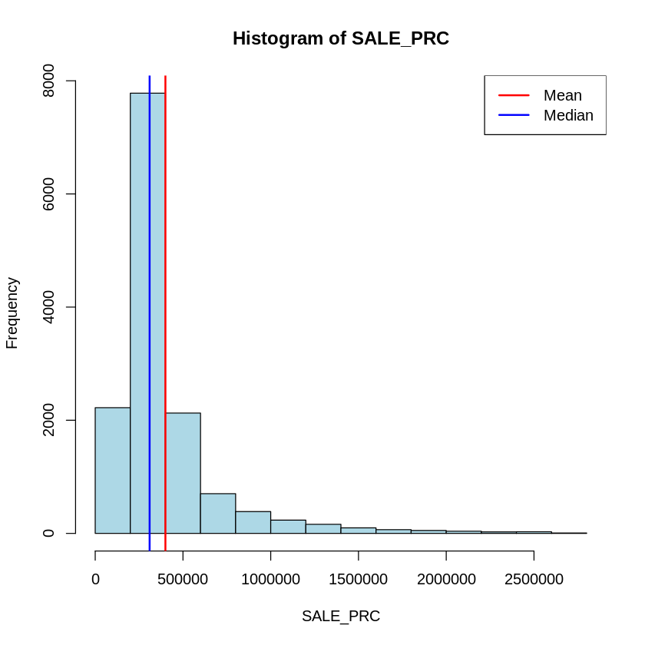
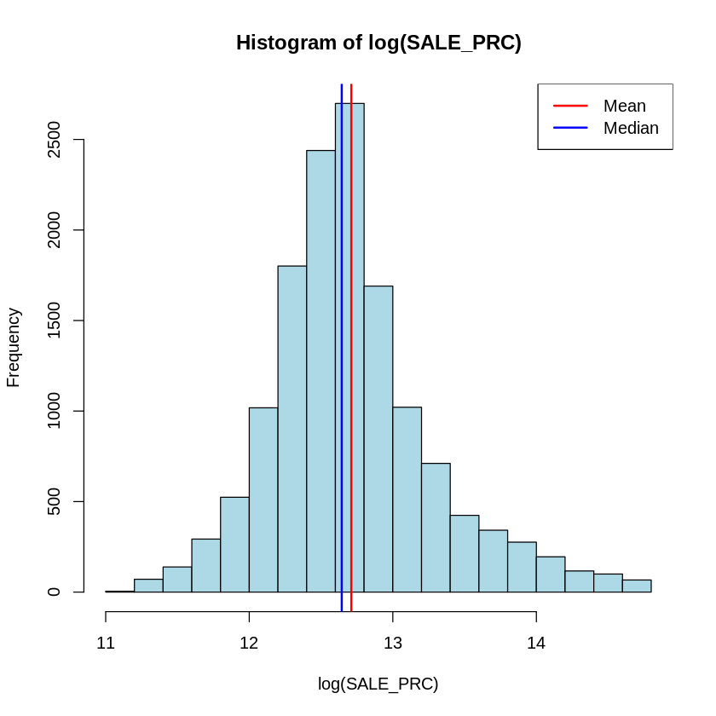
Sale Price Graphic
Distribution of Sale Price before and after log transformation
The median sale price is $310,000 & the mean sale price is around $400,000.

Slide 15
Variable Selection
Backward Step with AIC with log model
Start: AIC=-36726.94
log(SALE_PRC) ~ LND_SQFOOT + TOT_LVG_AREA + SPEC_FEAT_VAL + RAIL_DIST +
OCEAN_DIST + WATER_DIST + CNTR_DIST + SUBCNTR_DI + HWY_DIST +
age + avno60plus + structure_quality
Df Sum of Sq RSS AIC
- WATER_DIST 1 0.00 995.75 -36729
<none> 995.74 -36727
Step: AIC=-36728.9
log(SALE_PRC) ~ LND_SQFOOT + TOT_LVG_AREA + SPEC_FEAT_VAL + RAIL_DIST +
OCEAN_DIST + CNTR_DIST + SUBCNTR_DI + HWY_DIST + age + avno60plus +
structure_quality
Decreased AIC due to the removal of WATER_DIST, indicating a better balance between goodness of fit and simplicity

Slide 16
Variable Selection
Forward Step with AIC with log model
Start: AIC=-36726.94
lm(formula = log(SALE_PRC) ~ LND_SQFOOT + TOT_LVG_AREA + SPEC_FEAT_VAL +
RAIL_DIST + OCEAN_DIST + WATER_DIST + CNTR_DIST + SUBCNTR_DI +
HWY_DIST + age + avno60plus + structure_quality, data = normal)
Coefficients:
Estimate Std. Error t value Pr(>|t|)
WATER_DIST -0.0008809 0.0043673 -0.202 0.84

Slide 17
Dealing with Outliers
Studentized Residuals to identify the outliers
5% cutoff for outlier determination
We identified 808 outliers in the dataset
Action Taken: Exclude outliers in the final model

Slide 18
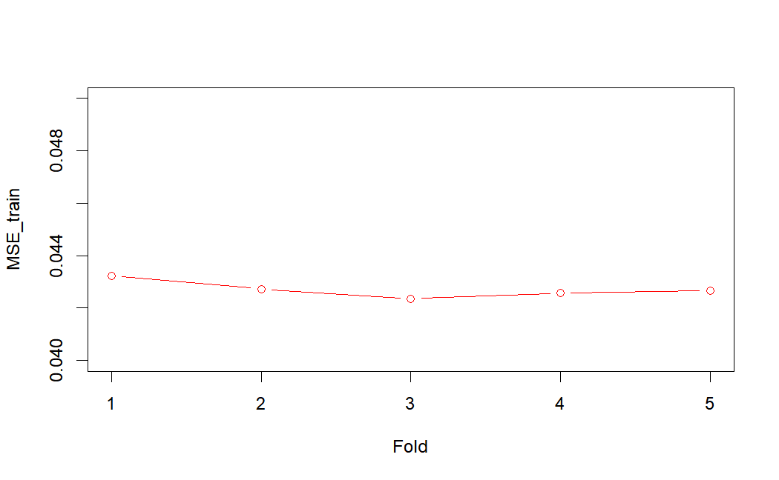
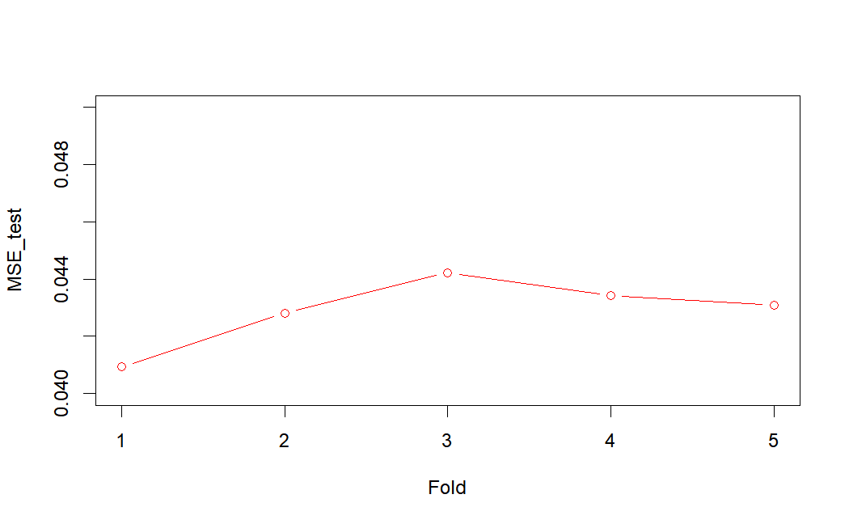
Cross Validation-5 folds
mean：
MSEs_train：0.04270769
MSEs_test：0.04289305

Slide 19
Final Model
lm(formula = log(SALE_PRC) ~ LND_SQFOOT + TOT_LVG_AREA + SPEC_FEAT_VAL +
RAIL_DIST + OCEAN_DIST + CNTR_DIST + SUBCNTR_DI + HWY_DIST +
age + avno60plus + structure_quality, data = miami_housing_no_outliers)

Slide 20
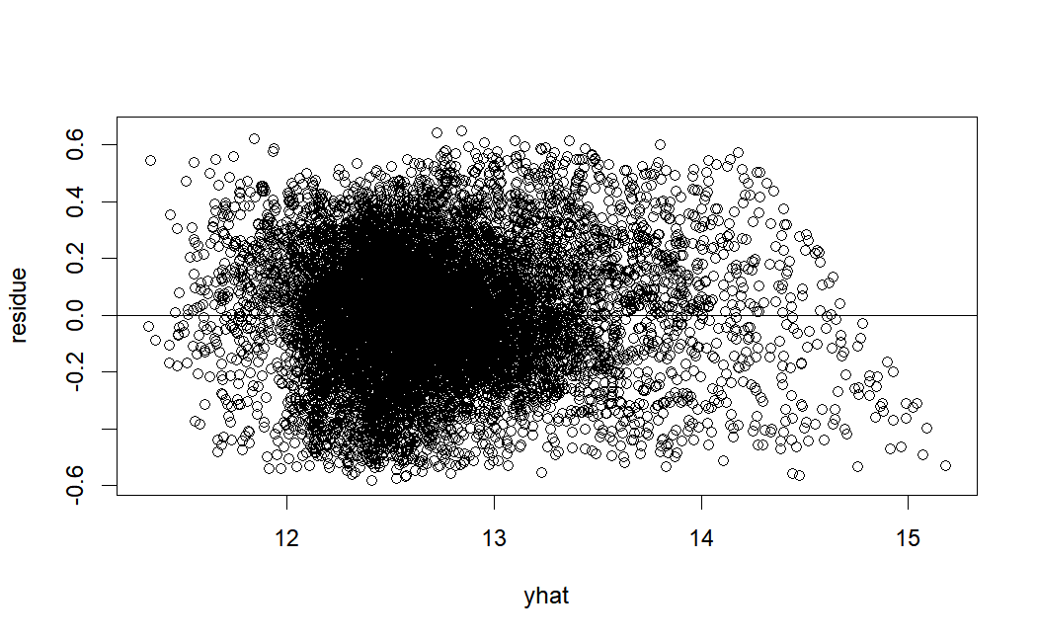
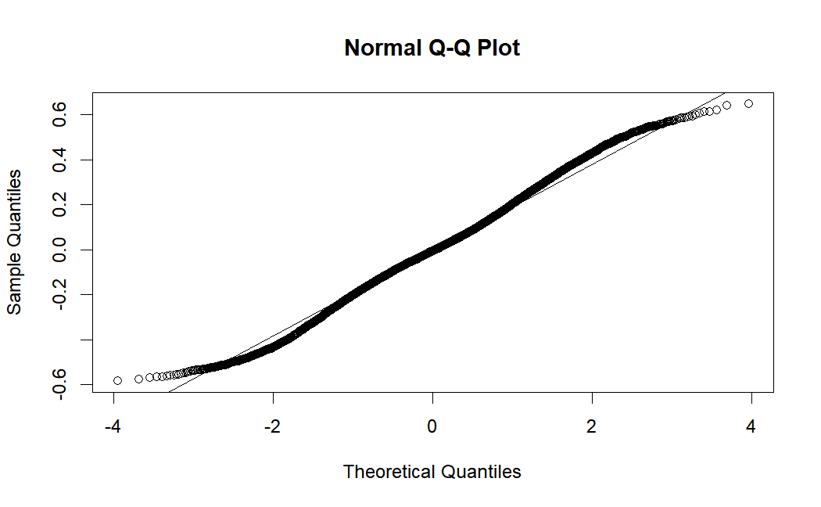
Residuals

Slide 21
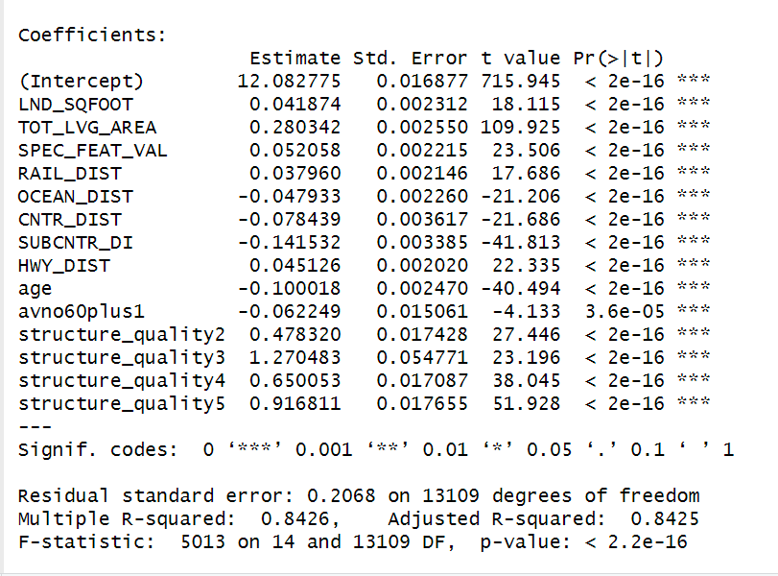
Model Performance

Slide 22
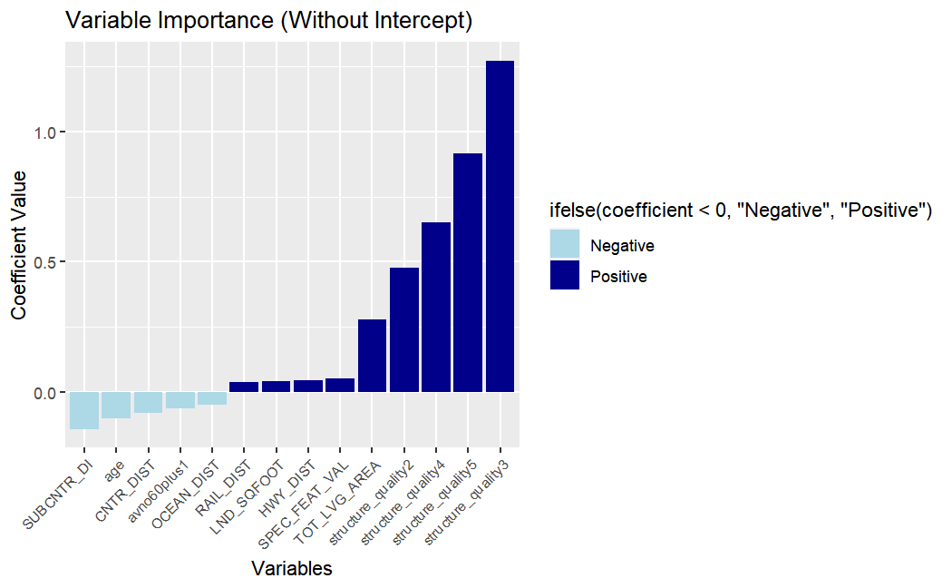
Feature Importance

Slide 23
Limitation
Data： Time limit： Data were collected Only in 2016
Lack time-related variables（e.g.interest rates and CPI）
Feature limit：Spatial variables are unhelpful.
Lack other potentially housing-related societal factors
（e.g.Population, school districts, and governmental policies）
Model: The model is too complex with many variables and transformation, making it
difficult for visualization and interpretation

Slide 24


Q & A

